Slide 1
Título em Português (Título em inglês aqui entre parênteses)
Student: Nome completo do bolsista
Advisor: Nome completo do orientador – e-mail do orientador
Co-advisor: Nome completo do co-orientador, caso tenha

Slide 2
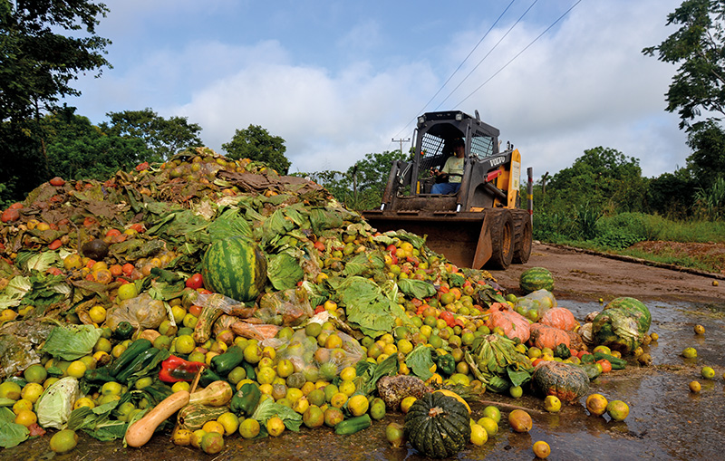
State of art
Usar no máximo 3 slides para Introdução/motivação. Após esses slides deverá ser apresentado os objetivos. Devem escrever os slides somente em inglês mas podem apresentar em qualquer idioma. Usar no máximo 12 slides ate o final das conclusões
In Brazil, agricultural losses amount to approximately 7.8% of Brazil's gross domestic product (GDP), about 10 billion reais. Vegetables, fruits and grains have a high degree of perishability, the equivalent of 30% to 40% of these foods gets lost from harvest to consumers[1]
Figure 1 - Food waste
(Fonte: )

Slide 3
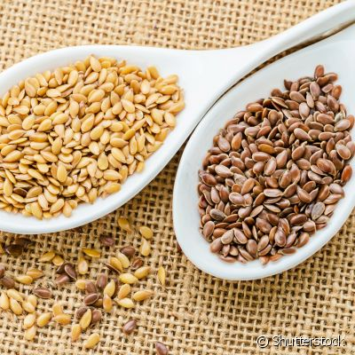
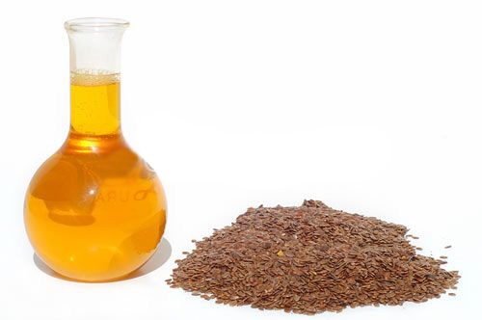
Figure 2 - Linseed oil [11].
To analyze the effects of the application of the atmospheric plasma, the seeds of linseed and soya were chosen.
Golden flaxseed, known scientifically as Linum usitatissimun, is composed of about 35-45% fat, 23-30% carbohydrates and 18-25% proteins [2].
Figure 1 - Golden and brown linseed [10].

Slide 4
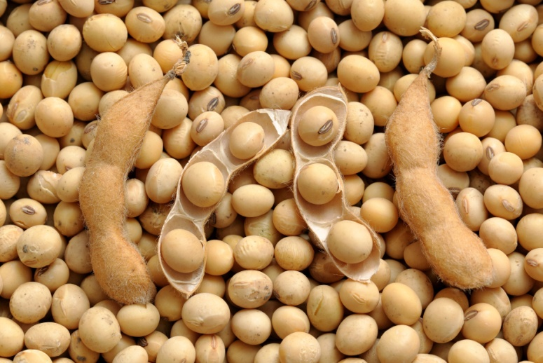
Figure 3 - Soya bean [12]
The soybean (Glycine max) is a grain that has high protein value, recognized as one of the main sources of protein and vegetable oil in the world [3].
It’s composed of 15%-20% of fat, 35%-40% of protein, 30% of carbohydrates, 10%-13% of moisture and about 5% of minerals [4].

Slide 5
Goals
Goals – Os objetivos deverão vir escritos com verbo direto.
  Objective: To study the microbiological evaluation after irradiation using atmospheric plasma in linseed oil and soybean oil.
  Specific objective.:
  To analyze whether the quality of the golden linseed oil and soybean oil was nutritionally affected.
  To analyze whether plasma treatment inhibited the growth of microorganisms.
  To analyze the morphology of seeds irradiated with atmospheric plasma.
  To analyze fungal succession of the golden linseed oil and soybean oil.

Slide 6
Methodology
Após os objetivos falar dos Materiais e métodos
  It will be made an irradiation of the seeds of golden linseed and soybean by atmospheric plasma, using a mixture of compressed air and argon gas, in the three times: 5, 10, and 15 minutes.
  Then, soybean oil and flaxseed oil will be extracted from the seeds by a Hydraulic press.
  Finally, the extracted oils will be analyzed by the…. (FTIR) technique for evaluation and comparison of the nutritional composition from treated samples.
  Teste biologico

Slide 7
Timeline
steps | Year (I)
 | Quarters
 | 1˚ | 2˚ | 3˚ | 4˚
1- Continues literature review in order to keep up to date on the state of the art. | x | x | x | x
2- Experimental setup with... ..... | x | x
3- Samples preparation | x | x
4 - Studies of parameters contribution ....using..... |  | x | x | x
5- Practice essays of... |  |  | x | x
6- Samples characterization using.... |  | x | x | x
7- Comparatively analyzes and repeat steps if necessary |  |  | x | x
8- Reports and manuscripts preparation |  |  |  | x
__ Concluded
__ To be concluded

Slide 8
Resultados e discussão

Slide 9
Conclusions
The conclusions will be about:
The analyze whether the quality of the golden linseed oil and soybean oil was nutritionally affected.

Slide 10
Conclusions
The conclusions will be about:
The analyze whether the quality of the golden linseed oil and soybean oil was nutritionally affected.

Slide 11
Conclusions
Conclusões devem finalizar no máximo no slide 12. O slide 13 deve ser usado com as referencias e no final das referencias é obrigatório colocar os agradecimento que deverão ser lidos no final da apresentação
The analyze whether the quality of the golden linseed oil and soybean oil was nutritionally affected.

Slide 12
References
[1] J. L. Passamai and J. C. S. Carneiro, “PLASMA FRIO APLICADO EM MANGAS DA VARIEDADE COQUINHO.”
[2] J. S. Magdalena Zuk, Dorota Richter, Jan Mattula, “LINSEED, THE MULTIPURPOSE PLANT.,” ndustrial Crop. Prod., vol. 75, p. pag. 165-177, 2015.
[3] M. Moreno, “VISTA COMO ALIMENTO IDEAL, SOJA PODE SE TORNAR VILÃ QUANDO CONSUMIDA EM EXCESSO.,” 2012.
[4] R. H. B. Fuchs, D. Borsato, E. Bona, and M. C. D. O. Hauly, “‘IOGURTE’ DE SOJA SUPLEMENTADO COM OLIGOFRUTOSE E INSULINA.,” Ciência e Tecnol. Aliment., vol. 25, no. 1, pp. 175–181, 2005.
[5] J. Guarino, “AVALIAÇÃO MICROBIOLOGICA APÓS A IRRADIAÇÃO COM PLASMA ATMOSFÉRICO EM SEMENTES DE LINHAÇA DOURADA.,” Universidade do Vale do Paraiba, 2017.
[6] A. G. C. Nathália M. Coutinho, Marcello R. Silveira, Sueli Rodrigues, “PLASMA A FRIO NA QUALIDADE E SEGURANCA DE LEITE E DERIVADOS.,” MilkPoint, 2016. .
[7] M. A. da S. Vasconcelos and A. B. Melo, “CONSERVAÇÃO DE ALIMENTOS.,” Univ. Fed. Rural Pernambuco, p. 122, 2010.
[8] T. L. T. L. Sousa et al., “VANTAGENS E DESVANTAGENS DA IRRADIAÇÃO NA CONSERVAÇÃO DE ALIMENTOS.,” pp. 4–6, 2013.
FIGURE
[9] (COMO DESMONTAR ESSA MAQUINA, 2016)
[10] “LINHAÇA MARROM E DOURADA - você sabe qual é a diferença entre elas?” .
[11] “ÓLEO DE LINHACA - faz mesmo emagracer?” .
[12] “EXPORTAÇÃO DE GRÃOS DE SOJA.”

Slide 13





Acknowledgements
GOVERNMENT AGENCIES
INSTITUTIONS
Lembrar de agradecer
Todas as agencias que contribuíram, as instituições e os ouvintes
Fundação de Amparo a Pesquisa
Do Estado de São Paulo
(Project number …..)
Ministério da Ciência e Tecnologia
Agência Espacial Brasileira
Conselho Nacional de Desenvolvimento
Científico e Tecnológico
Instituto Tecnológico de Aeronáutica
Thank you for your kind attention!
Ministério da Ciência e Tecnologia

